Slide 1
Experimental Results

Slide 2
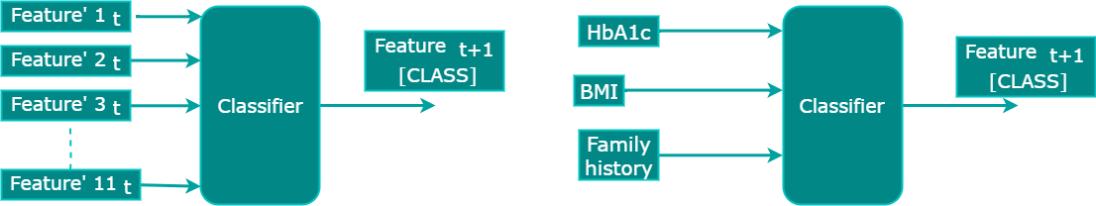
Experimental Results
Algorithms used for the experiment
Random forest (RF)
XGBoost
Support vector machine (SVM)
Ensemble of the three algorithms (RF, SVM & XGBoost) - StackingClassifier
1. With the selected 11 features
2. With the traditional predictors

Slide 3
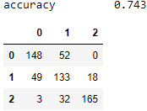
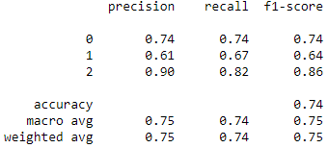
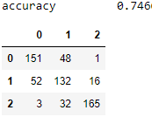
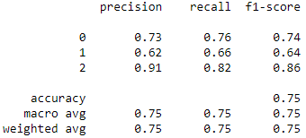
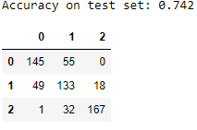
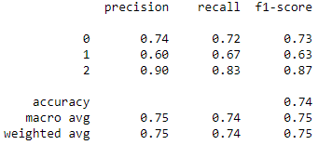
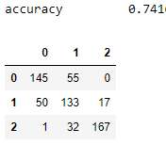
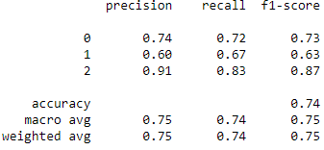
Results – Classifier with 11 features
XGBoost
10 fold Cross Validation
Accuracy: 0.73 (+/- 0.01) [RF]
Accuracy: 0.73 (+/- 0.01) [XGBoost]
Accuracy: 0.73 (+/- 0.02) [SVM]
Accuracy: 0.73 (+/- 0.01) [StackingClassifier]
Training dataset size: D=842, PD=‭1,684‬, ‭N=1,684‬
The testing dataset contains 200 instances per class
SVM
RF
Stacking Classifier

Slide 4
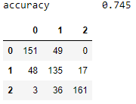
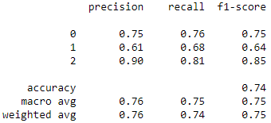
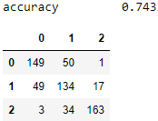
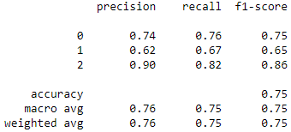
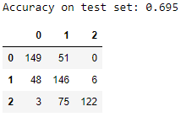
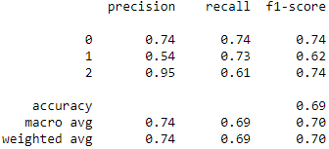
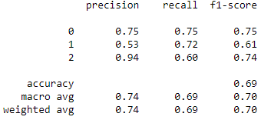
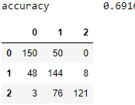
Results – Classifier with 11 features using synthetic data
XGBoost
10 fold Cross Validation
Accuracy: 0.77 (+/- 0.04) [RF]
Accuracy: 0.72 (+/- 0.04) [XGBoost]
Accuracy: 0.72 (+/- 0.03) [SVM]
Accuracy: 0.77 (+/- 0.04) [StackingClassifier]
Training dataset size: D=17,105 , PD=‭17,105 ‬, ‭N=17,105 ‬
The testing dataset contains 200 instances per class
SVM
RF
Stacking Classifier

Slide 5
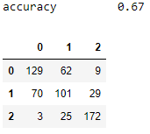
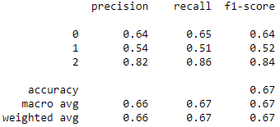
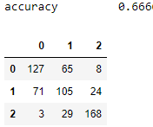
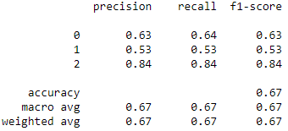
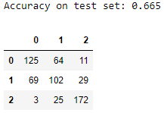
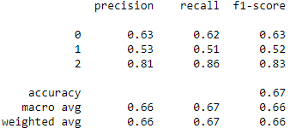
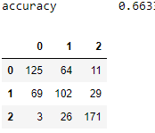
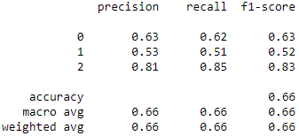
Results – Classifier with traditional predictors (HbA1c, BMI, family history)
XGBoost
10 fold Cross Validation
Accuracy: 0.64 (+/- 0.01) [RF]
Accuracy: 0.65 (+/- 0.01) [XGBoost]
Accuracy: 0.65 (+/- 0.01) [SVM]
Accuracy: 0.64 (+/- 0.01) [StackingClassifier]
Training dataset size: D=956, PD=‭1,912‬, ‭N= 1,912‬
The testing dataset contains 200 instances per class
SVM
RF
Stacking Classifier

Slide 6
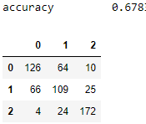
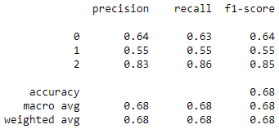
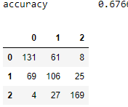
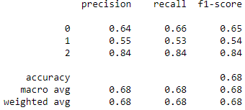
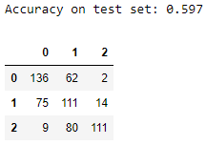
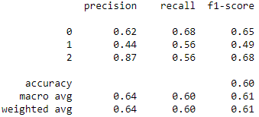
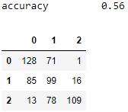
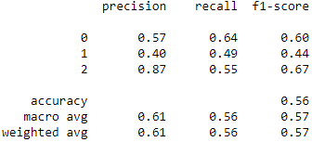
Results – Classifier with traditional predictors (HbA1c, BMI, family history) using synthetic data
XGBoost
10 fold Cross Validation
Accuracy: 0.70 (+/- 0.02) [RF]
Accuracy: 0.66 (+/- 0.01) [XGBoost]
Accuracy: 0.64 (+/- 0.01) [SVM]
Accuracy: 0.70 (+/- 0.01) [StackingClassifier]
Training dataset size: D=18,508 , PD=‭ 18,508‬, ‭N= 18,508
The testing dataset contains 200 instances per class
SVM
RF
Stacking Classifier

Slide 7
Conclusion
Based on the experimental results we can deduce the following
the accuracy of the models with 11 features is better than that of the models with the traditional predictors
overall accuracy of the next year's prediction model with 11 features has shown a minor improvement as compared to the previous approach

